Slide 1
Candidate Service

Slide 2
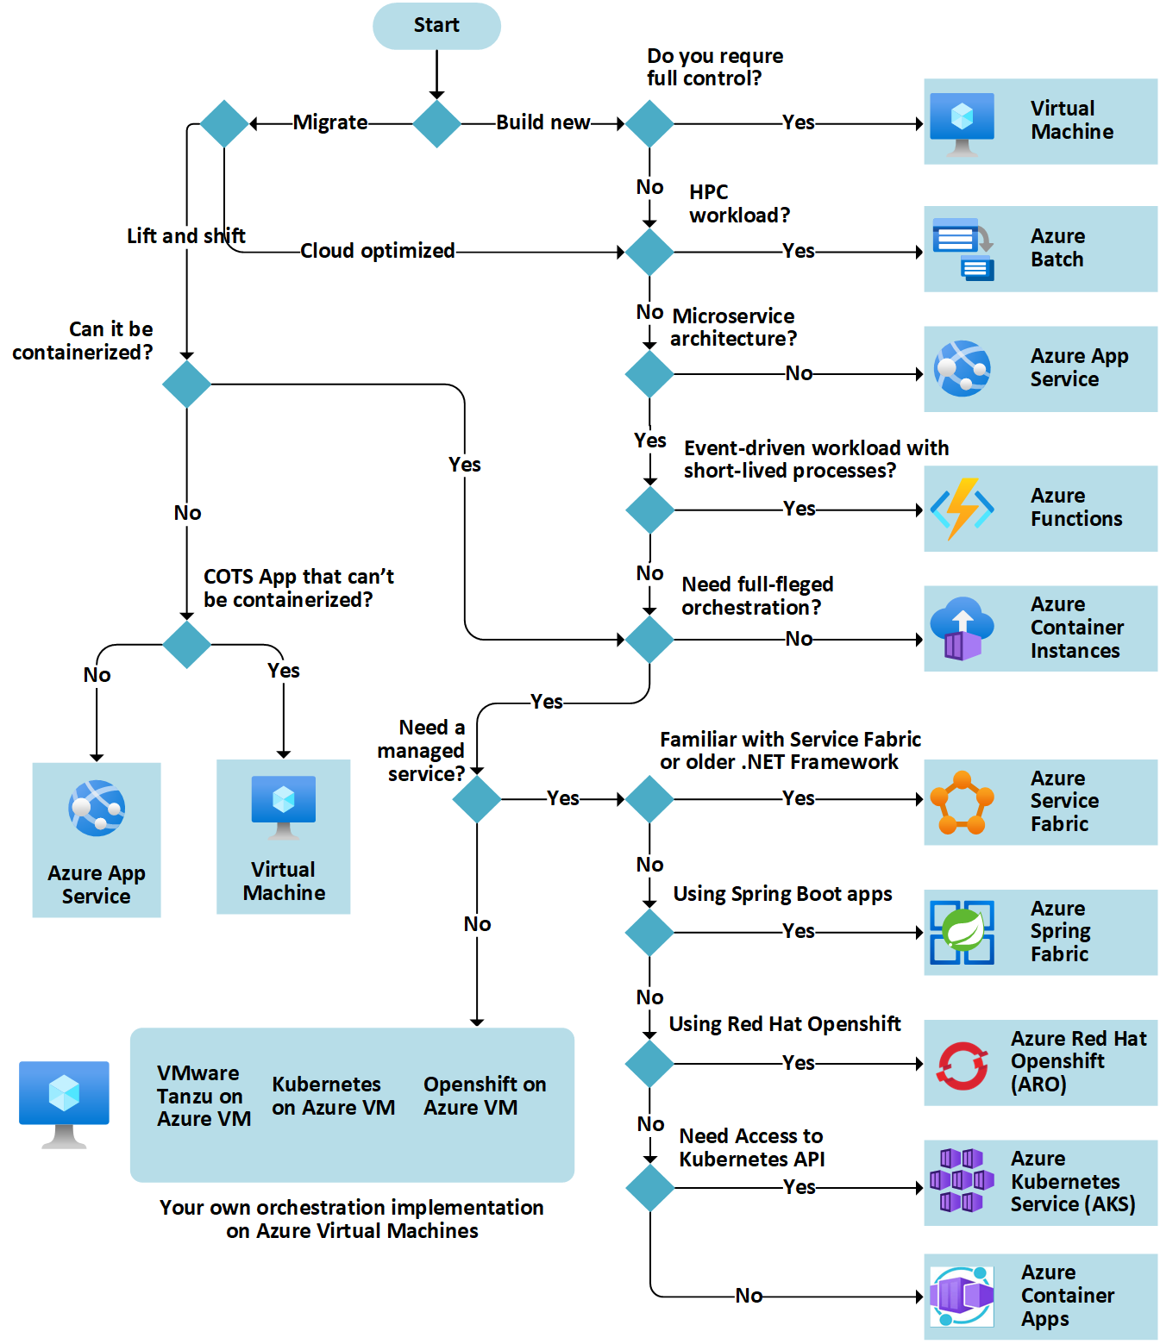
Compute

Slide 3
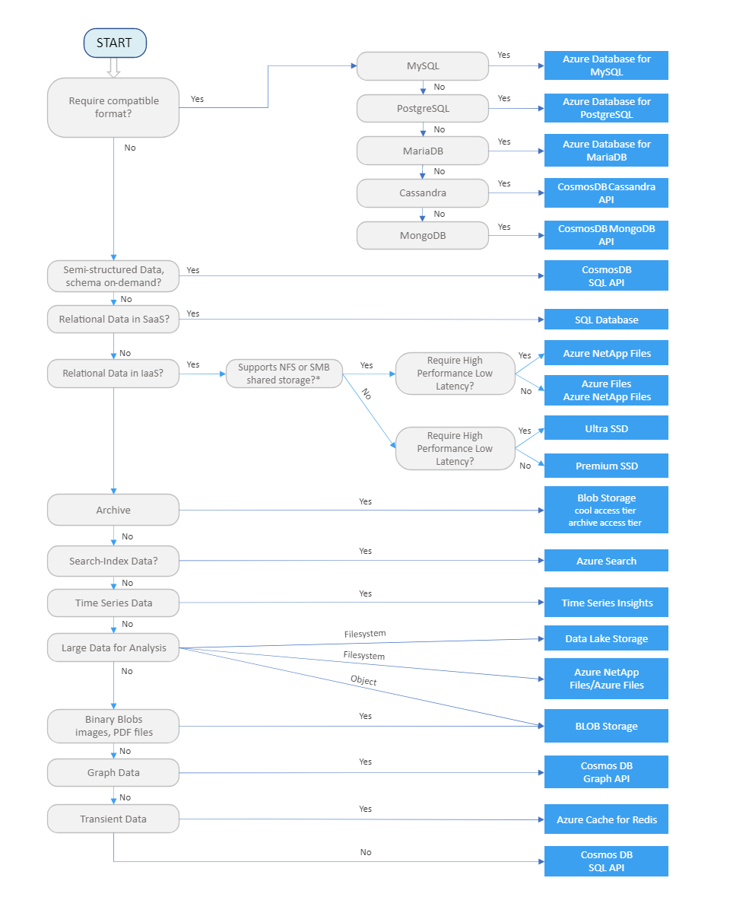
Data Store

Slide 4
